Slide 1


AZ-300 - Microsoft Azure Architect Technologies
Jordan Radkov
Cloud Solution Architect

Slide 2

Implement Workloads and Security (20-25%)

Slide 3
Series Agenda
1 | Deploy and Configure Infrastructure (25-30%)
2 | Implement Workloads and Security (20-25%)
3 | Create and Deploy Apps (5-10%)
4 | Implement Authentication and Secure Data (5-10%)
5 | Develop for the Cloud (20-25%)

Slide 4
Series Agenda
Deploy and Configure Infrastructure (25-30%)
Implement Workloads and Security (20-25%)
3
Create and Deploy Apps (5-10%)
4
Implement Authentication and Secure Data (5-10%)
5
Develop for the Cloud (20-25%)

Slide 5

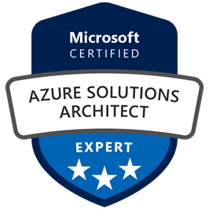
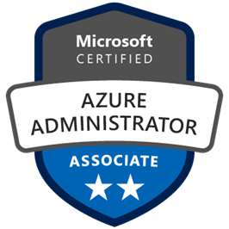
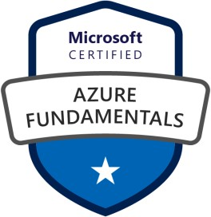



Jordan Radkov
Cloud Solution Architect based in the Munich
10+years in the industry in infrastructure administration , automation and now cloud
Constant learner - Ancora Imparo

Slide 6
Objectives
Migrate servers to Azure
May include but not limited to: Migrate by using Azure Site Recovery (ASR); migrate using P2V; configure storage; create a backup vault; prepare source and target environments; backup and restore data; deploy Azure Site Recovery (ASR) agent; prepare virtual network
Configure serverless computing
May include but not limited to: Create and manage objects; manage a Logic App resource; manage Azure Function app settings; manage Event Grid; manage Service Bus
Implement application load balancing
May include but not limited to: Configure application gateway and load balancing rules; implement front end IP configurations; manage application load balancing

Slide 7
Objectives (cont.)
Integrate on premises network with Azure virtual network
May include but not limited to: Create and configure Azure VPN Gateway; create and configure site to site VPN; configure Express Route; verify on premises connectivity; manage on-premise connectivity with Azure
Manage role-based access control (RBAC)
May include but not limited to: Create a custom role; configure access to Azure resources by assigning roles; configure management access to Azure; troubleshoot RBAC; implement RBAC policies; assign RBAC roles
Implement Multi-Factor Authentication (MFA)
May include but not limited to: Enable MFA for an Azure tenant; configure user accounts for MFA; configure fraud alerts; configure bypass options; configure trusted IPs; configure verification methods; manage role-based access control (RBAC); implement RBAC policies; assign RBAC Roles; create a custom role; configure access to Azure resources by assigning roles; configure management access to Azure

Slide 8
Module 1 Migrate servers to Azure

Slide 9
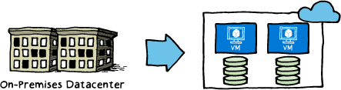
Migration Goals
Technology-focused and business-focused, including:
Addressing the hardware obsolescence cycle
Moving away from the ‘pre-purchase capacity’ model
Lack of IT agility
Desire to re-focus on core competencies
Expense of maintaining a global presence
Enable disaster-recovery scenarios

Slide 10
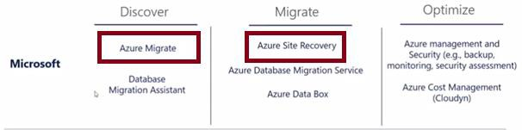
Migration Phases
When planning for migration to Azure, consider the following phases:
Discover: gain better visibility of on-premises workloads and assess the optimal resource level to run them in Microsoft Azure.
Azure Migrate is the primary tool for this, and includes:
Automated server, app, and database discovery.
Intelligent workload right-sizing and costing for maximum ROI.
Workload configuration analyses and recommendations.
Migrate: move selected workloads to Azure.
Azure Site Recovery is the primary tool for this and includes:
Lifting and shifting of servers, apps, databases, and data.
Containerization of existing applications and infrastructure
Modernization options for apps and databases.
Optimize: fine tune your Azure-based workloads and maximize your ROI.
There are many Microsoft partners to help you with backup, monitoring, security assessments, and cost management.

Slide 11

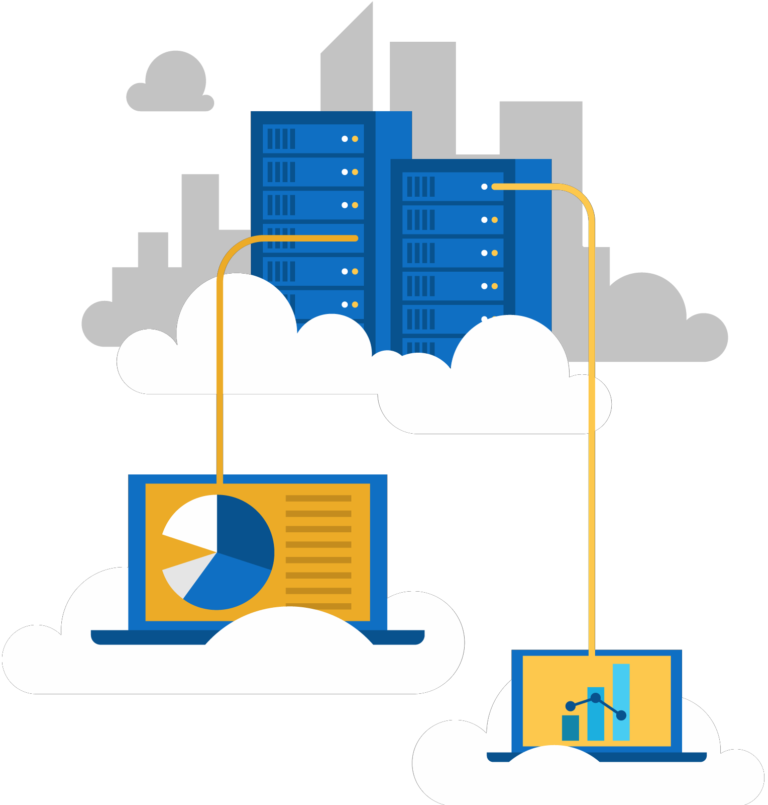

Slide 12
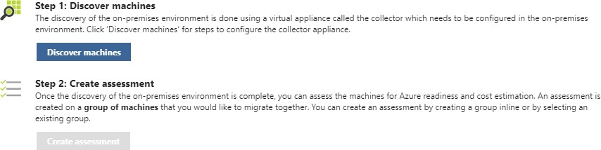
Azure Migration Service
Provides assessment of on-premises workloads for migration to Azure:
migration suitability of on-premises machines performance-based sizing
cost estimates for running your on-premises machines on Azure VMs
Follows two steps: Discover machines Create Assessments

Slide 13
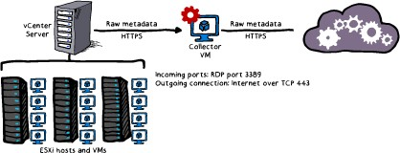
Using Azure Migrate: A Look ahead
Architecture:
Closely integrated with the components of an VMware vCenter environment
Process
Create a project Discover the machines Collect the information Assess the project

Slide 15
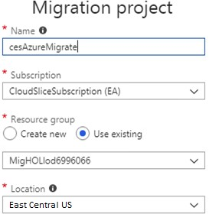
Creating a Project
The initial step of the Azure Migrate
A project contains metadata representing on-premises environment:
Name Subscription Resource Group Location
Discovery records of VMware VMs
Project limits:
Up to 1,500 discovered VMs per project Up to 1,500 assessed VMs per project Up to 20 projects per subscription

Slide 16
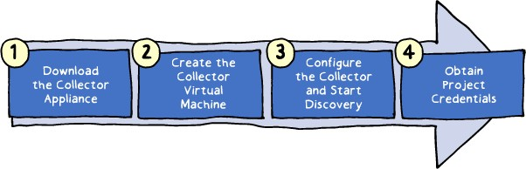
Creating a Collector
A virtual appliance which handles discovery Implementation consists of four main steps:
Downloading the Collector appliance (an Open Virtualization Appliance (.ova) file
downloadable from the Azure Migrate project in the Azure portal)
Creating the Collector virtual machine by importing the .ova file on the vCenter server Configuring the Collector to initiate discovery
Assigning to the Collector project credentials including Azure Migrate project ID and key

Slide 17
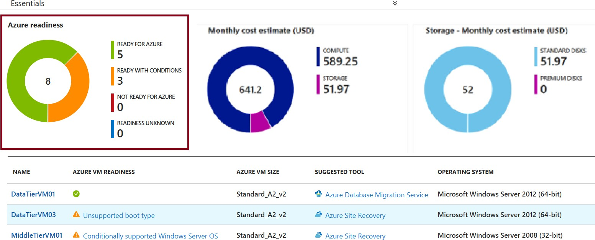
Assessing Readiness
Assessment is based on the readiness status of discovered VMs:
Ready for Azure (green): along with the recommended Azure VM size
Ready with conditions (Orange) and Not ready for Azure (Red): including readiness issues and
remediation steps.
Readiness unknown (Blue)

Slide 18
Assessing VM Sizing
Azure Migrate VM assessment offers two types of sizing :
Performance-based sizing (default) which takes into account:
Storage: maps the size and performance of VM disks to Azure VM disks
Network: identifies Azure VM sizes that offer matching number and performance of network adapters Compute: determines CPU and memory requirements based on performance history of discovered VMs On-premises sizing:
Matches the size of on-premises VM to an equivalent Azure VM Does not take into account performance history of discovered VMs

Slide 19
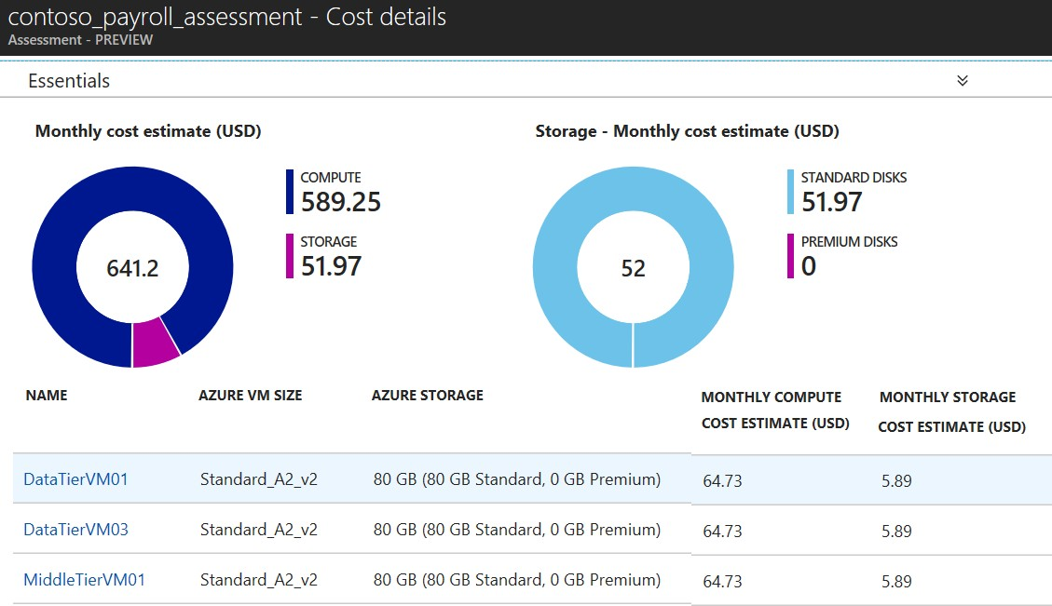
Estimating Cost
Provides the total costs of Azure VMs:
Compute: aggregated monthly cost, which takes into account:
OS type
Software Assurance Reserved Instances VM uptime
VM location currency settings
Storage: aggregated monthly cost.
No offer specific settings

Slide 20
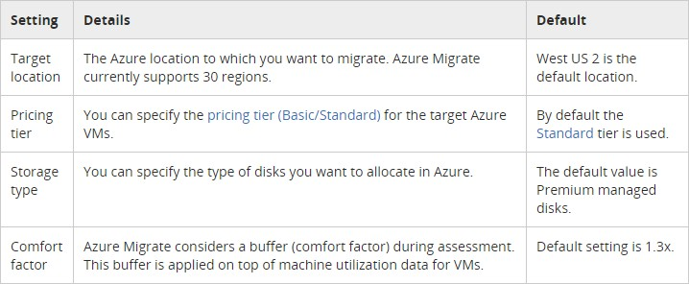
Customizing the Assessment
Customization settings include: Performance history duration Target location
Pricing tier Storage type Comfort factor Currency Discounts
VM uptime

Slide 21
Troubleshooting Azure Migrate
The most common issues include:
Migration project creation failed
No performance data
Collector is not able to connect to the internet
Date and time synchronization error
Error UnableToConnectToServer

Slide 22
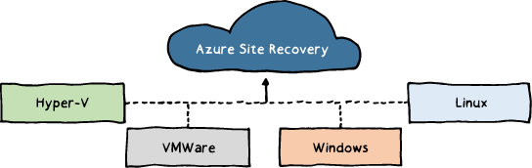
ASR Scenarios
Hyper-V VM replication:
Hyper-V with Virtual Machine Manager (VMM):
Replication to Azure or a secondary datacenter.
Hyper-V without VMM:
Replication to Azure only.
VMware VM replication:
Replication to a secondary site running VMware or to Azure.
Physical Windows and Linux machines:
Replication to a secondary site running VMware or to Azure.

Slide 23
ASR Features
Eliminating the need for disaster recovery sites
Reducing infrastructure costs
Automatically replicating to Azure
Safeguarding against outages of complex workloads
Extending or boosting capacity
Continuous health monitoring

Slide 24






Slide 26
Configuring Azure
Delegate permissions within the target Azure subscription:
Virtual Machine Contributor built-in role Site Recovery Contributor built-in role Create an Azure Storage account: General Purpose
Read-access geo-redundant Secure transfer: Disabled
Create an Azure virtual network:
Ensure sufficient bandwidth for intersite replication

Slide 27
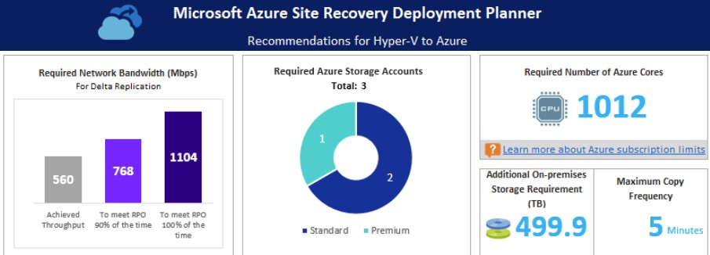
ASR Deployment Planner
A command line tool for profiling Hyper-V VMs to estimate:
Intersite network bandwidth requirements Azure Storage requirements
Generates a report including:
On-premises summary Recommendations VM storage placement Compatible VMs Incompatible VMs Storage requirement
Initial Replication batching Cost estimate

Slide 28
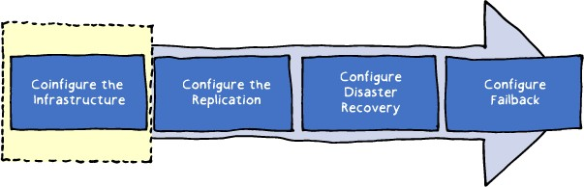
Configure the Infrastructure: Requirements
Verify Hyper-V operating system requirements:
Windows Server 2016 (including server core installation) Windows Server 2012 R2 with latest updates.
Mixing hosts running Windows Server 2016 and 2012 R2 isn't supported.
Verify Hyper-V host and guest storage requirements:
Hyper-V host storage can include SMB 3.0, SAN (iSCSI), and Multi-path (MPIO). No support for shared cluster disks and encrypted disks.
Verify internet access:
Hyper-V hosts should have direct access to the internet without using a proxy.
Prepare Windows VMs for access
following a failover (optional)

Slide 29
Configure the Infrastructure: Process
The Azure portal driven sequence:
Protection goal (e.g. replicating Hyper-V machines to Azure)
Source environment (e.g. Hyper-V site)
Target environment (e.g. a resource group in an Azure subscription)
Replication settings
Deployment planning

Slide 30
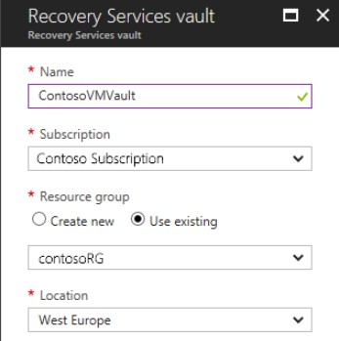
Recovery Services Vault
Hosts ASR metadata and replicated VM disks Can be created directly from the Azure portal Serves as the primary configuration interface

Slide 32



Slide 33
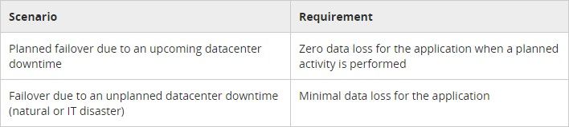
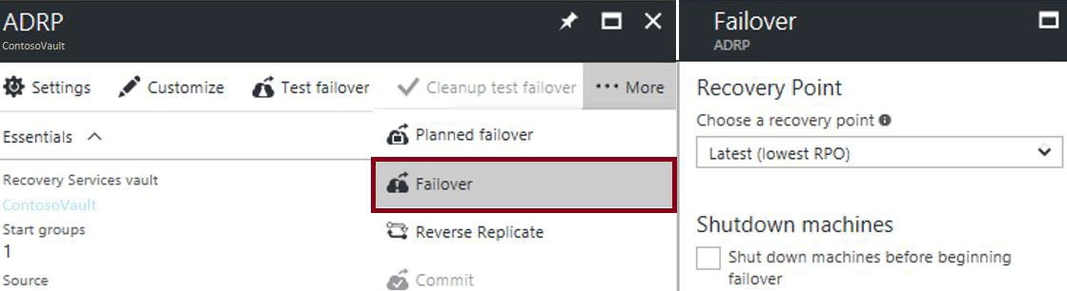
Planned and Unplanned Failovers
ASR facilitates two types of failover:
Planned: guaranteed no data loss
Unplanned: possible data loss
ASR failovers:
are not automatic
can be initiated from the Azure p
ortal

Slide 34
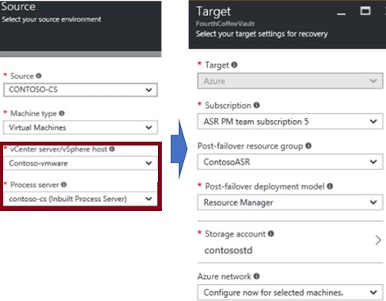
Enable Replication
Start by configuring:
Replication source
Replication target

Slide 35
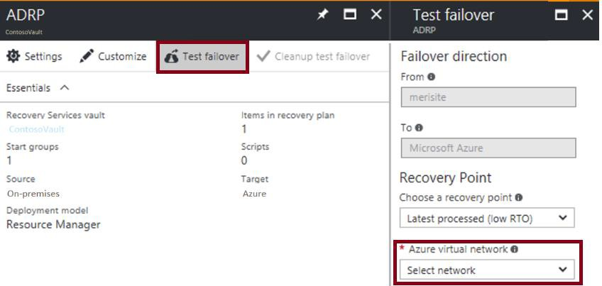
Test Failover
No-impact validation of replication and disaster recovery strategy:
Does not affect ongoing replication and the production environment
Supports single or multiple VMs
Does not require downtime
Does not introduce data loss
Best practices:
Use failover groups
Failover to an isolated network
Integrate with Azure Automation

Slide 36
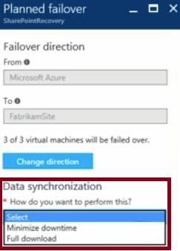
Failback
A planned failover back to the primary site
Offers two data synchronization methods:
Full download:
Faster
Requires VMs to be shut down
Minimize downtime:
Slower
Eliminates the need to shut down VMs

Slide 37
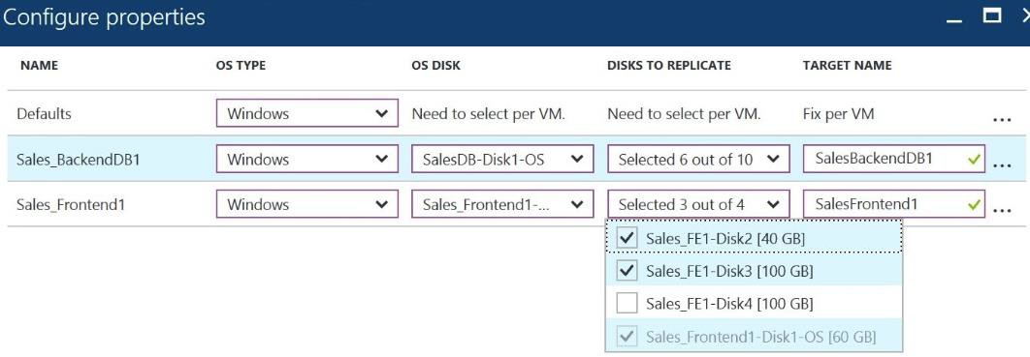
Virtual Machine Replication
To configure:
Select source computers
For each, select the OS type, OS disk, and data disks to replicate
Optionally, exclude disks (e.g. disks hosting a paging file)
For each, specify the name of a target VM

Slide 38







Slide 39
Configure serverless computing
Notes:
Module 2 - Implementing and Managing Application Services Deploying Web Apps
Web Apps Features

Slide 40
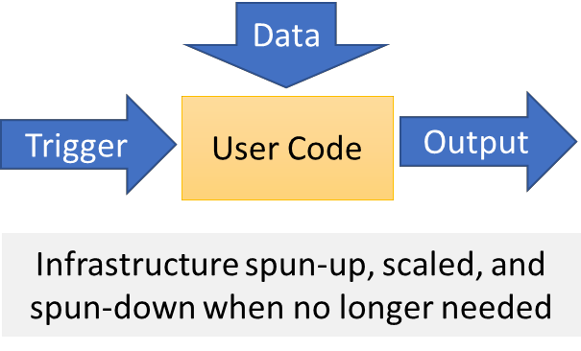
Serverless Computing
Abstracts servers, infrastructure, and operating systems
Reacts to events and triggers in near-real time
Offers a range of benefits:
Eliminates management overhead
Allows developers to focus on business logic
Implements flexible scaling
Reduces costs

Slide 41
Serverless Applications
Compute:
Azure Functions
Cloud Messaging:
Event Grid
Service Bus
Workflow Orchestration:
Logic Apps

Slide 42
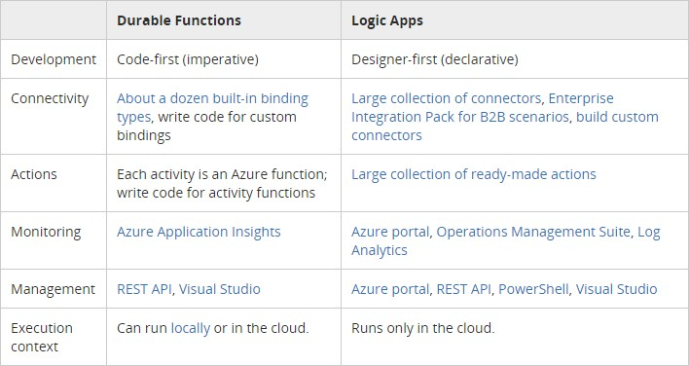
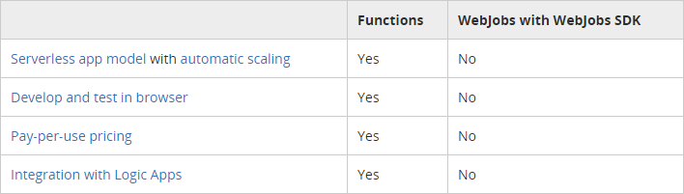
Comparing Serverless Options

Slide 43

Managing Logic App

Slide 44
Logic Apps
Implement scalable integrations and workflows
Include a visual designer to model workflows
Offer built-in connectors for cloud and on-premises services and apps
Provide a range of benefits, including:
Getting started quickly from templates.
Saving time by designing complex processes using easy to understand design tools.
Implementing patterns and workflows seamlessly, that would otherwise be difficult to implement in code.
Customizing your logic app with your own custom APIs, code, and actions.
Connecting and synchronizing disparate systems across on-premises and the cloud.

Slide 45
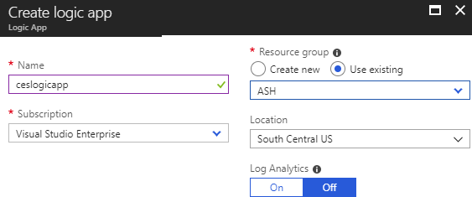
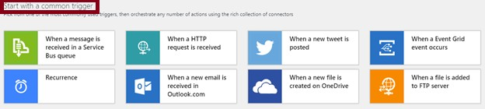
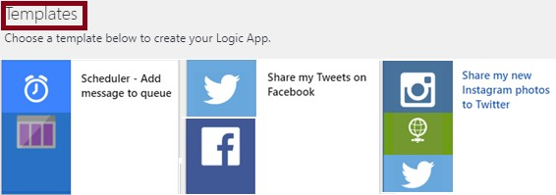
Implementing Logic Apps
From the Azure portal:
To create a logic app, provide:
Name
Subscription
Resource Group
Location
To configure a logic app:
Use the Logic Apps Designer to:
Add triggers
Add connectors
Leverage templates

Slide 46
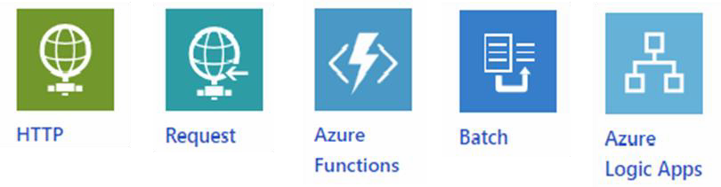
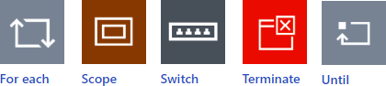
Built-in Triggers and Actions
•
Triggers:
•
•
•
•
•
•
Recurrence HTTP
Request
Azure Functions Batch
Logic Apps
•
Actions:
•
•
•
•
•
•
Condition For each Scope Switch Terminate Until

Slide 47
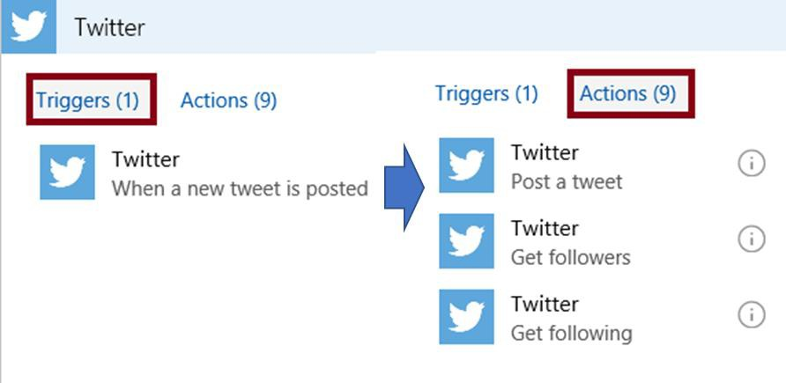
Managed Connectors
200+ built-in connectors, including:
Managed API connectors:
Azure Blob Storage, Office 365, Dynamics, Power BI, OneDrive, Salesforce, and SharePoint Online.
On-premises connectors:
SQL Server, SharePoint Server, Oracle DB, Twitter, Salesforce, Facebook, and file shares.
Integration account connectors:
Require a paid-for integration account
Transform and validate XML
Encode and decode flat files
Process B2B messages
Enterprise connectors:
Incur extra cost
Provide access to enterprise systems:
Support SAP and IBM MQ.

Slide 48
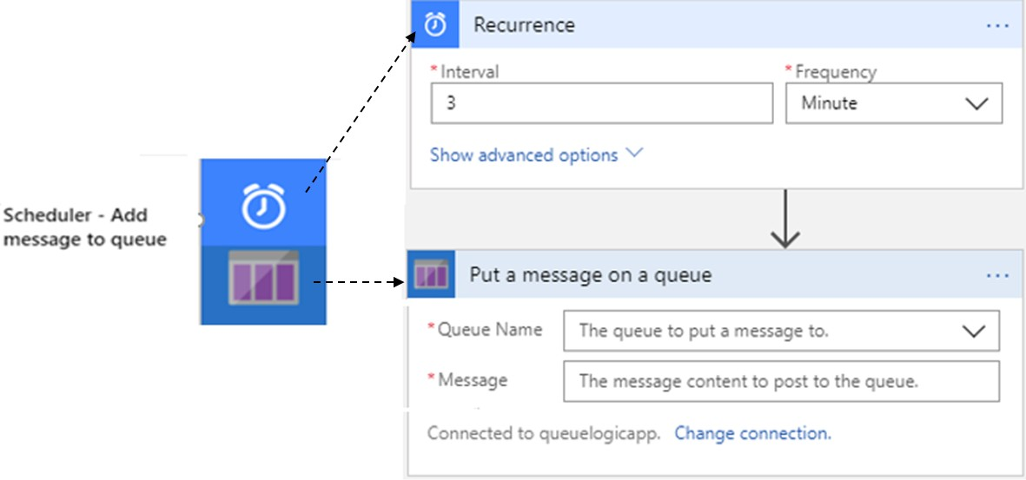
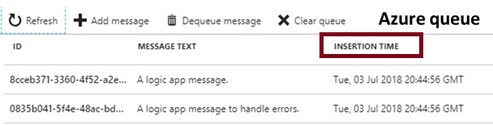
Logic App Example
The Scheduler logic app consists of:
Recurrence:
Controls scheduling
Put a message on a queue:
Designates the target Storage queue

Slide 49
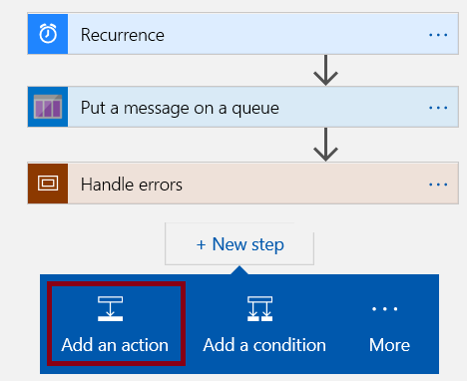
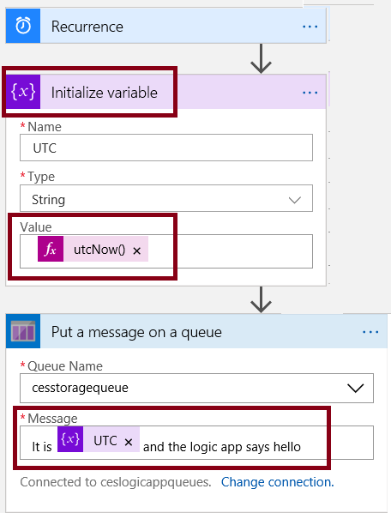
Logic App Example (cont.)
To customize the workflow:
Add a extra action:
Variable (Initialize Variable)
Modify the action sequence
Add variable to the message

Slide 50
Managing Azure Functions

Slide 51
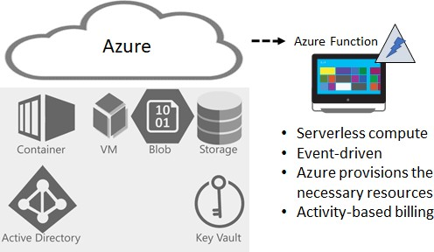
Overview of Azure Functions
Serverless compute service:
Eliminates the need to explicitly provision or manage infrastructure
Enables running code on-demand or in response to a trigger Incurs charges only when active

Slide 52
Features of Azure Functions
Support for a range of programming languages:
C#, F#, Node.js, Python, PHP, batch, bash, or any executable.
Pay-per-use pricing model
Support for custom dependencies:
NuGet and NPM-based libraries.
Integration with the most popular OAuth providers:
Azure AD, Facebook, Google, Twitter, and Microsoft Account. Integration with other Azure services and SaaS apps. Flexible development:
Directly from the Azure portal
Via continuous integration through GitHub, VSTS, and other supported development tools.
Open-source: available on GitHub.
Ease of code reuse:
Developers can reuse their functions in multiple applications.

Slide 53
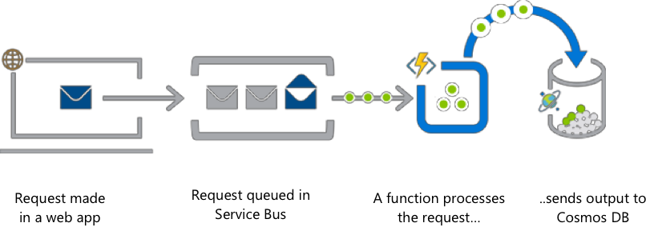
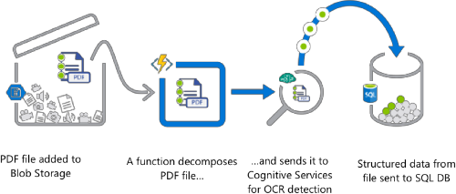
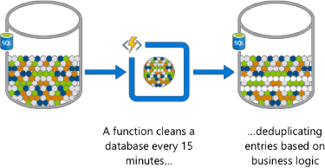
Azure Functions (Examples)
Web app backend
Real-time file processing
Automation of scheduled tasks

Slide 54
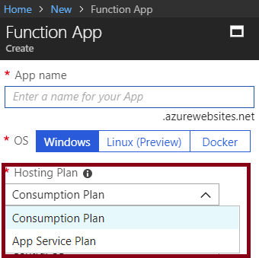
Function Service Plans
Hosting plans:
Consumption Plan:
Azure provides all the necessary compute resources on-demand
Automatic scaling of CPU and memory Billing is based on:
number of executions execution time memory used.
App Service Plan:
The same resource and billing model as for web, mobile, and API apps Allows for leveraging underutilized App Service deployments Required for Linux-based function apps

Slide 55
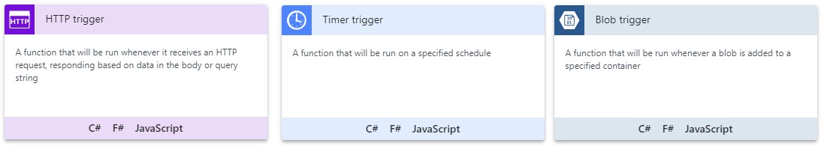
Function Templates
Simplify creating functions for a specific trigger type:
HTTP
Timer Blob Event Hub GitHub Webhook Queue

Slide 56
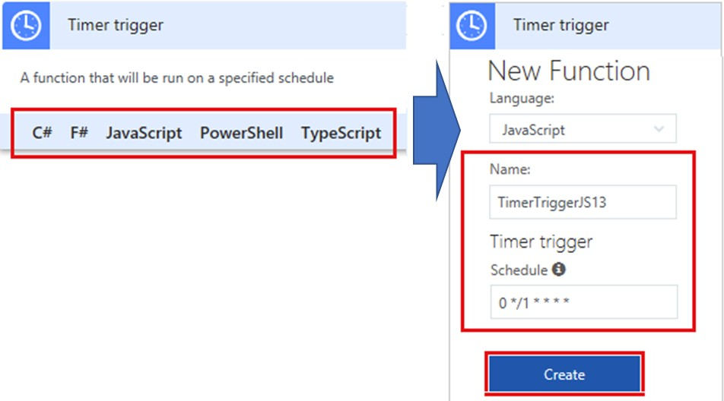
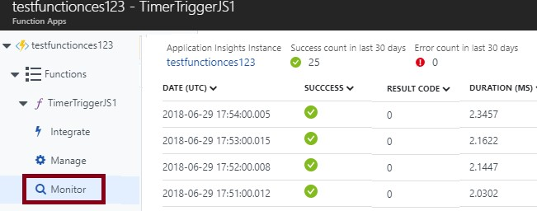
Implementing Functions
In-portal authoring
In-portal monitoring

Slide 57
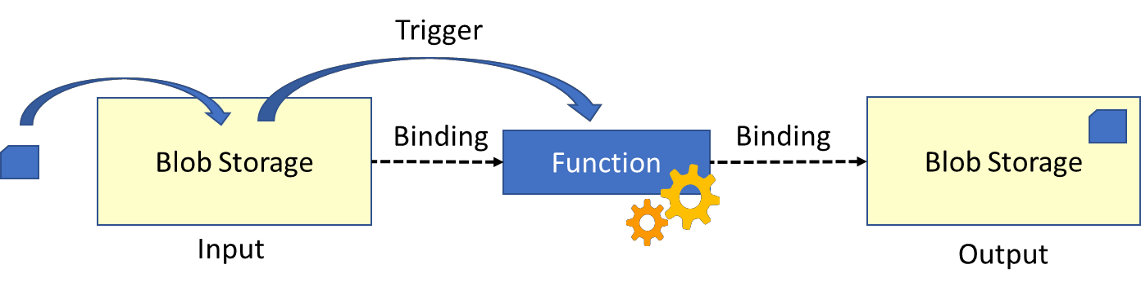
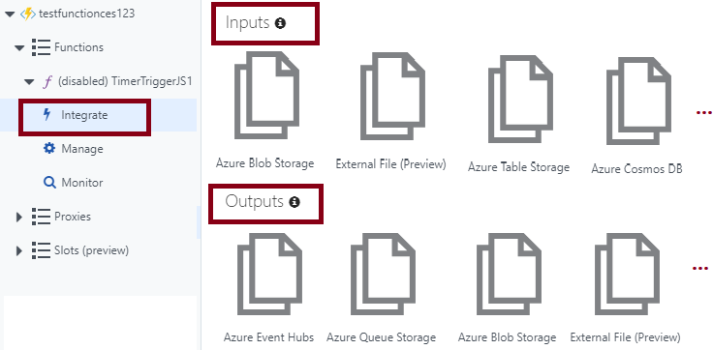
Bindings
Link functions to other services as:
Inputs
Outputs
Configurable in the Azure portal:
Accessible via the Integrate link

Slide 58
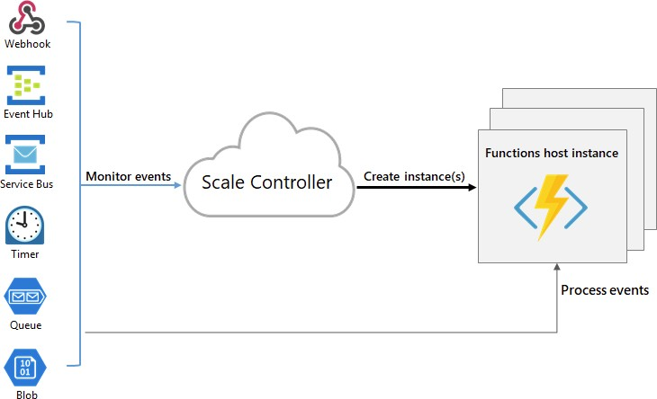
Function Scaling
Relies on the platform-managed Scale Controller Scale Controller:
Monitors the rate of events Controls horizontal scaling Relies on heuristics:
E.g. for Queue Storage trigger:
The queue length
The age of the oldest message

Slide 59
Manage Event Grid

Slide 60
Overview of Event Grid
Managed event routing service with a wide range of benefits:
Simplifies event delivery:
Connects multiple event sources and destinations, including virtually all Azure services and custom
sources
Provides fully managed event delivery, intelligent filtering, and the ability to send events to multiple recipients at once
Eliminates polling and the associated cost and latency
Decouples event publishers from subscribers by using a pub/sub model and HTTP-based event delivery, Simplifies building scalable serverless applications, microservices, and distributed systems.
Facilitates developing reliable cloud applications:
Supports massive auto-scaling with near-real-time notifications for changes Implements reactive programming leveraging guaranteed event delivery Promotes focus on product innovation

Slide 61
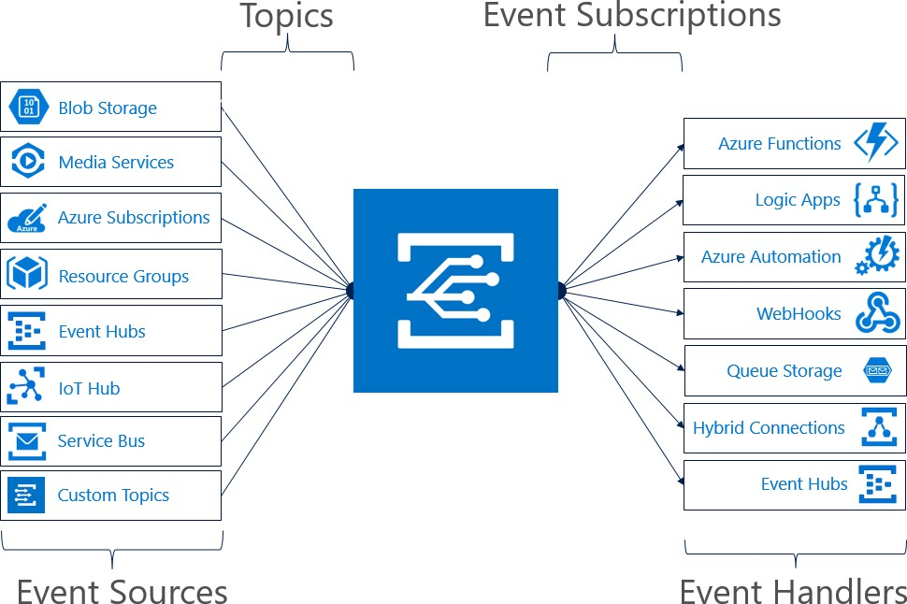
Event Grid Concepts
Event Sources Topics
Event Subscriptions Event Handlers

Slide 62
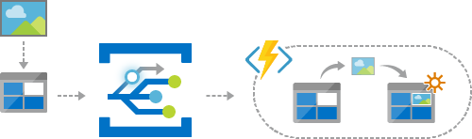
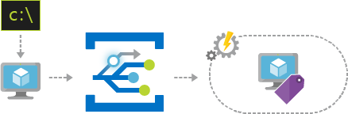

Event Grid Examples
Serverless application architecture
Ops automation Application integration

Slide 63





Implementing Event Grid (Part 1)
Implementation components:
Event source: Azure Blob Storage Event Handler: Azure Queue Storage Implementation steps (part 1):
Create an Azure Storage account (Blob storage)
Create an Azure Storage account (general purpose v1))
Create an Azure Storage queue
Create the event source:
Use the When a new blob is uploaded template
Configure the event source:
When prompted, provide the Blob storage account

Slide 64


Implementing Event Grid (Part 2)
Implementation steps (part 2):
Edit the Logic App:
One condition: True whenever a blob is created
One action: Add a message to the queue.
Save changes and start the Logic App
Create an storage container and upload a blob
View messages in the Storage queue
To avoid future charges, delete all resources

Slide 65
Managing Service Bus

Slide 66

Queues
Azure Service Bus Queues provide:
Asynchronous, brokered messaging
Temporal decoupling of message senders and receivers Structured message processing
Publish/subscribe capabilities
First In, First Out (FIFO) message delivery

Slide 67

Topics and Subscriptions
One-to-many communication in a publish/subscribe pattern Useful for scaling large number of recipients
Each published message is available to topic-registered subscriptions Subscriptions use filters to designate messages to receive

Slide 68

Service Bus Features
Load Leveling Loose Coupling Load Balancing

Slide 69


Implementing Service Bus
Implementation steps:
Creating a Service Bus namespace
Obtaining management credentials
Creating queues and topics
Writing code to send/receive messages
Managing and monitoring queues and topics

Slide 70


Creating the Namespace
Available directly from the Azure portal:
Name: globally identifies the namespace
Pricing tier: determines capacity and capabilities
Basic Standard Premium
Generates a SAS policy:
Includes:
Primary key Secondary key
Grants full control to the namespace

Slide 71

Create a Queue
Available directly from the Azure portal: Name: identifies the queue within the namespace Max queue size
Message time to live Lock duration
Enable duplicate detection Enable dead lettering Enable sessions
Enable partitioning

Slide 72

Monitoring Service Bus
Available directly from the Azure portal:
A rich set of metrics: Namespace level Queue/topic/message level Diagnostic logs:
Capture all queue activities

Slide 73

Comparing Service Bus and Storage Queues

Slide 74
Quiz

Slide 75
You develop an Azure solution for your company. You have access to an Azure Web App with high traffic demands. A team of developers makes constant changes to the code. You need to ensure that new changes can be published to the Web App without causing dropped requests. What should you configure? A)Clone options for the Web App B)Deployment Slot on the Web App correct C)Automation Script on the Web App D)Continuous Deployment on the Web App
Notes:
When you deploy your Web App to App Service, you can deploy to a separate deployment slot instead of the default production slot.
This can decrease downtime for high traffic Web App since the instances for the slot will already be warmed up.
Hence the correct answer is B)

Slide 76
You develop an Azure solution that includes a published Web App. You need to authenticate all users of the Web App by using Azure Active Directory. Which two steps should you perform on the Web App? A)Enable App Service Authentication. B)Enable Application Insights. C)Configure SSL Certificates. D)Configure an Authentication Provider. E)Enable Security Scanning.
Notes:
You can easily implement user authentication for a Web App by enabling App Service Authentication and configuring an Authentication Provider such as Azure AD.
Correct answer is A) and D)

Slide 77
Implement application load balancing

Slide 79

Load Balancer
Operates on OSI Layer 4 (TCP/UDP)
Relies on health probes to determine status of backend pool Distributes traffic according to load balancing rules

Slide 80

Public Load Balancer
Distributes traffic targeting a public IP address across backend VMs:
Frontend has one or more public IP addresses Backend VMs have private IP addresses

Slide 81

Internal Load Balancer
Distributes traffic targeting a private IP address across backend VMs:
Frontend has one or more private IP addresses Backend VMs have private IP addresses Supports load balancing:
Within a virtual network
For a cross-premises virtual network For multi-tier applications
For line-of-business applications

Slide 82

Load Balancer SKUs
Two SKUs:
Basic Standard
Constraints and considerations:
SKUs are not mutable.
An Azure VM, Availability Set, or Azure VM Scale Set can reference one SKU, not both. A Load Balancer rule cannot span two virtual networks.
There is no charge for the Basic load balancer.
The Standard load balancer is charged based on number of rules and data processed.

Slide 83


Backend Pool
Configuration depends on the load balancer SKU:
Standard:
Up to 1,000 Azure VMs in the same virtual network, including VMs in availability sets and VM scale sets.
Basic:
Up to 100 VMs in the same availability set or VM scale set.

Slide 84


Load Balancer Rules
Determine traffic distribution Require existing:
Frontend IP Backend pool Health probe
Can be used with NAT rules:
Allow connections to specific backend VMs

Slide 85

Multiple Frontends
Azure Load Balancer supports load balancing on:
Multiple IP addresses Multiple ports
Multiple IP addresses and ports
Two types of rules map frontend and backend pool configurations:
The default rule with no backend port reuse
The floating IP rule where backend ports are reused
Rule type 1: No backend port reuse:
Frontends are configured with:
IP address, protocol, and port
Backend pool VMs expose each service on:
The same DIP and a unique port

Slide 86
Multiple Frontends (Rule 2)
Rule type 2: backend port reuse by using Floating IP
Requires enabling Floating IP in the rule definition:
Each backend pool VM has three network interfaces:
DIP. A Virtual NIC associated with the VM (IP configuration of Azure's NIC resource)
Frontend 1. A loopback interface within guest OS that is configured with IP address of Frontend 1 Frontend 2. A loopback interface within guest OS that is configured with IP address of Frontend 2
The destination of the inbound flow is the frontend IP address on the loopback interface in the VM.
By changing the destination IP address, you can enable port reuse on the same VM.

Slide 87


Session Persistence
Load balancing uses a hash to map traffic to backend pool VMs:
5-tuple (source IP, source port, destination IP, destination port, and protocol type)
Stickiness applies only within a transport session.
You can change the default session persistence (None) to:
Client IP
Client IP and protocol

Slide 88


Health Probes
Evaluate status of load balanced workloads: Unhealthy threshold set to 2 consecutive failures (default) Interval set to 15 second (default)
Support two protocols:
HTTP:
Expects HTTP 200 OK response
TCP:
Tests for a successful TCP session

Slide 90

Application Gateway Components
Application Gateway is a load balancer operating on OSI Layer Its components include:
Frontend IP configuration Backend server pool Listeners, including:
front-end port
protocol (HTTP or HTTPS) SSL certificate (optional). Rules
Web application firewall (WAF)

Slide 91


Web Application Firewall
Provides protection for backend server pool workloads:
Protects against common cyber threats (SQL injection, cross-side scripting, etc.) Uses OWASP rules
Allows disabling rules that result in false positives

Slide 92


Health Probes
By default, health probes relies on healthy HTTP responses Custom probes provide more control:
Facilitate more thorough health checks
Support custom values of:
Minimum healthy servers Unhealthy threshold Interval
Timeout Path

Slide 93


Application Gateway Sizing
Application Gateway is available in 3 SKUs: Small: intended for development and testing only Medium
Large

Slide 94


Path-Based Routing
Directs traffic based on target URL, e.g.:
/images to one backend pool
/video to another backend pool
To implement:
Specify the path pattern, e.g.:
/images/* and /video/*

Slide 95


Multiple Site Hosting
Allows multiple web sites on the same Application Gateway instance:
Each with its own backend pool Up to the total of 20 web sites To implement:
Create 2 backend pools Create 2 listeners Create 2 routing rules
Arrange the rules in the intended order
Rules are processed in the order in which they are listed

Slide 96
Secure Sockets Layer Offload
Provides SSL termination at the gateway:
Eliminates performance impact of decryption on the backend pool VMs Requires uploading certificate and binding it to the appropriate listener

Slide 97

Redirection and Session Affinity
Redirection:
Protocol redirection:
Typically HTTP to HTTPS
Path-based redirection:
Apply protocol redirection for specific path only:
e.g. /cart/*
Redirection to external sites
Session affinity:
Cookie-based
Directs traffic to the same backend pool VM

Slide 98
Integrate on premises network with Azure virtual network

Slide 99



Slide 100


Site-to-Site VPN Connections
IPSec IKEv1 or IKEv2 VPN tunnels:
Cross-premises VNet-to-VNet Multi-site:
Requires a route-based VPN

Slide 101

Site-to-Site Scenarios
Capacity On-Demand Strategic Migration Disaster Recovery

Slide 102


Implementing Site-to-Site VPN
Create VNets and subnets
Specify the DNS server (optional)
Create the Gateway subnet
Create the VPN Gateway
Create the Local Network Gateway
Configure the VPN device
Create the VPN Connection

Slide 103


Gateway Subnet
Requires an IP range of /28 or larger Must be named GatewaySubnet
Should not be associated to any Network Security Groups

Slide 104


VPN Gateway
Establishes IPSec tunnel: Handles traffic encryption Supports multiple connections One per GatewaySubnet Supports two VPN types: Route-based
Policy-based
Supports four SKUs
Basic, VpnGw1, VpnGw2, VpnGw3

Slide 105


Local Network Gateway
In hybrid scenarios, represents on-premises VPN device To configure, specify:
Name
IP address: the public IP address of the VPN device
Address space: one or more on-premises IP address ranges

Slide 106

Configure the VPN Device
Follow instructions provided by Microsoft or device manufacturer:
Microsoft provides a list of the validated VPN devices
The configuration settings include:
A shared key
The public IP address of the VPN gateway

Slide 107



Configure the VPN Connection
Establishes IPSec tunnel between:
Azure VPN gateway Local network gateway Requires:
Shared key matching the one you used in the previous step

Slide 108


Verify the VPN Connection
The Azure portal:
Identify the connection status:
Connected Succeeded
Note the Data in and Data out values
Azure Powershell:
Run the Get-AzureRmVirtualNetworkGatewayConnection cmdlet Examine the values of:
connectionStatus ingressBytesTransferred egressBytesTransferred

Slide 109


Slide 110

ExpressRoute
Private connection that extends on-premises network to:
Microsoft Azure Office 365
Dynamics 365 Benefits: Enhanced reliability Higher bandwidth Lower latency Increased security
Common scenarios: Data migration Business continuity

Slide 111

ExpressRoute Connection Options
Cloud Exchange Co-location
Point-to-point Ethernet Connection Any-to-any (IPVPN) Connection

Slide 112

Site-to-Site and ExpressRoute Coexisting Connections
Configuration:
VPN gateway and ExpressRoute gateway are deployed to the same GatewaySubnet
Benefits:
Extended scope of connectivity
A cost effective failover

Slide 113
Manage role-based access control (RBAC)

Slide 114

Role-Based Access Control
Select a role (the definition of what actions are allowed and/or denied)
Associating the role with a security principal (user, group, or service)
Scope to a subscription, a resource group, or a specific resource

Slide 115

Role-Based Access Control
Facilitates granular access to Azure resources: Consists of:
Role definition
Role assignment
Scope of assignment
Can be managed by using:
The Azure portal Azure PowerShell Azure CLI
ARM templates

Slide 116

Built-in Roles
A role represents a set of permissions to carry out specific actions Azure AD provides many built-in roles:
Built-in, not resource specific, including:
Owner: full access to all resources including the right to delegate access to others.
Contributor: creating and managing all resources but without the ability to delegate access to others. Reader: viewing all resources (except for secrets).
Built-in, resource specific (e.g. Virtual Machine Contributor)
A role is described by a JSON-formatted role definition:
Name, Id, Actions, Not Actions, AssignableScopes
Can be retrieved by Get-AzureRmRoleDefinition

Slide 117

Role Definitions
Actions and NotActions:
Include or exclude actions associated with the role
AssignableScopes:
/subscriptions/[subscription id]
/subscriptions/[subscription id]/resourceGroups/[resource group name]
/subscriptions/[subscription id]/resourceGroups/[resource group name]/[resource]

Slide 118
Azure PowerShell and CLI
To automate role management, you can use:
Azure PowerShell:
New-AzureRmRoleDefinition -InputFile .\sysops.json
New-AzureRmRoleAssignment -RoleDefinitionName $roleName `
-SignInName $assigneeName `
-ResourceGroupName $resourceGroupName
Azure CLI:
az role definition create --role-definition “./sysops.json”
az role assignment create --role $roleName \
--assignee $assigneeName \
--resource-group $resourceGroupName

Slide 120

Built-in Roles
Azure AD has many built-in roles
Owner has full access to all resources including the right to delegate access to others.
Contributor can create and manage all types of Azure resources but can’t grant access to others
Reader can view existing Azure resources

Slide 121
Role Definitions
Each role has a role definition defined in a JSON file
The Actions and NotActions properties allow or deny actions
The AssignableScopes property specifies the affected subscriptions, resource groups, or resources
Name: Owner
ID: 8e3af657-a8ff-443c-a75c-2fe8c4bcb65 IsCustom: False
Description: Manage everything, including access to resources
Actions: {*} NotActions: {} AssignableScopes: {/}

Slide 122
Role Assignments (PowerShell and CLI)
For large numbers of role assignments, use PowerShell or the CLI
#Role assignment properties
$roleName = “Contributor”
$assigneeName = josh@microsoft.com
$resourceGroupName = “contosoblue”
Azure PowerShell
New-AzureRmRoleAssignment -RoleDefinitionName $roleName -SignInName
$assigneeName -ResourceGroupName $resourceGroupName
CLI
az role assignment create –role $roleName –assignee $assigneeName –resource-group
$resourceGroupName

Slide 123
Implement Multi-Factor Authentication (MFA)

Slide 124

Azure MFA Concepts
The security of MFA two-step verification lies in its layered approach
Authentication methods include:
Something you know (typically a password)
Something you have (a trusted device that is not easily duplicated, like a phone)
Something you are (biometrics)

Slide 125
Azure MFA Features
Get more security with less complexity
Mitigate threats with real-time monitoring and alerts
Deploy on-premises or on Azure
Use with Office 365, Salesforce, and more
Add protection for Azure administrator accounts

Slide 126
MFA Licensing and Pricing
There are three pricing methods for Azure MFA.
Consumption based billing
Per user. You can pay per user. Each user has unlimited authentications. Use this model if you know how many users you have and can accurately estimate your costs.
Per authentication. You can pay for a bundle (10) of authentications. Use this model when you are unsure how many
users will participate in MFA authentication.
MFA licenses included in other products
Direct and Volume licensing

Slide 127
Microsoft Authenticator App
Prevent unauthorized access to accounts
Stop fraudulent transactions by giving you an additional level of security
Use either as a second verification method or as a replacement for your password when using phone sign-in
The app can work in one of two ways:
Notification. The app sends a notification to your device, then Verify or Deny
Verification code. Open the app and copy the verification code onto the sign-in screen

Slide 128

MFA for Global Admins
Free
Ad
ma
Seco aut
Use
of charge for global administrator security
ded level of security when managing and creating Azure resource chines
ndary authentication includes phone call, text message, and th henticator app
the portal to enable MFA for administrators
s, like virtual
e

Slide 129
What are You Trying to Secure?
What are you trying to secure | Azure MFA | MFA Server
First-party Microsoft apps | ● | ●
SaaS apps in the app gallery | ●
Web applications published through Azure AD App Proxy | ●
IIS applications not published through Azure AD App Proxy |  | ●
Remote access such as VPN, RDG | ● | ●

Slide 130
Where Are Your Users Located?
User Location | Azure MFA | MFA Server
Azure Active Directory | ●
Azure AD and on-premises AD using federation with AD FS | ● | ●
Azure AD and on-premises AD using Azure AD Connect - no password hash sync or pass- through authentication | ● | ●
Azure AD and on-premises AD using Azure AD Connect - with password hash sync or pass-through authentication | ●
On-premises Active Directory |  | ●

Slide 131
What Features Do You Need?
Feature | Azure MFA | MFA Server
Mobile app notification and mobile app verification code as a second factor | ● | ●
Mobile app verification code as a second factor | ● | ●
Phone call or one-way SMS as second factor | ● | ●
Hardware Tokens as second factor |  | ●
PIN mode |  | ●
Fraud alert and MFA reports | ● | ●
Remember MFA for trusted devices | ●
Conditional access | ● | ●

Slide 132


Slide 133

Video

Slide 134







Slide 135

Authentication Method | Usage
Password | MFA and SSPR
Security questions | SSPR Only
Email address | SSPR Only
Microsoft Authenticator app | MFA and Public Preview for SSPR
SMS | MFA and SSPR
Voice call | MFA and SSPR
App passwords | MFA only in certain cases

Slide 136







Slide 137





Slide 138





Slide 139


Conditions – “When this happens”
Access controls – “Then do this”

Slide 140





Slide 141


Practice: Conditional Access

Slide 142

Practice: MFA Authentication Pilot

Slide 143




Slide 144



Slide 145




